Slide 1
Yacc

Slide 2
What is Yacc
Yacc: Yet Another Compiler-Compiler
A LALR(1) parser generator
Read rules from a specification file (*.y file)
Using *.y to Generate the lexical analyzer in C language
*.tab.c and *.tab.h file
Contain a yyparse() function – the parser
bison is a later implementation of yacc.

Slide 3
Simple compiler
A compiler can scan the character stream into tokens and then analyze the syntax of the token stream, but Yacc can only analyze the syntax .
How to complete a compiler ?
Using Lex to scan characters into tokens and Yacc to analyze the syntax of the token stream.

Slide 4
Cooperation of Yacc and Lex
Using .y file to generate *.tab.c and *.tab.h file
Using .l file to generate *.yy.c file
Link .c generated by yacc and lex
bison –d -o “file_name”.tab.c “file_name”.y
gcc -c -g -I.. “file_name”.tab.c
flex –o “file_name”.yy.c “file_name”.l
gcc -c -g -I.. “file_name”.yy.c
gcc -o “file_name” “file_name”.tab.o “file_name”.yy.o -ll

Slide 5
Cooperation of yyparse() and yylex()

Slide 6
Example code 加法分析器 ex1.l
%{
#include "y.tab.h"
%}
%%
\n { return(0); /* EOF */ }
[ \t]+ { /* do nothing */ }
[0-9]+ { yylval.ival = atoi(yytext);return(INUMBER); }
"+"|"("|")" { return(yytext[0]); }
. { return(yytext[0]); }
%%

Slide 7
Lex part of Cooperation
*.l file need to include the *.h file , which is actually generated by yacc/bison
#include "y.tab.h“
Lex return token’s values to Yacc
yylval.ival = atoi(yytext);
return(INUMBER);
return(yytext[0]);
yylval
This is a variable defined in *.y file
When token is returned to yacc , yacc can use it to do something

Slide 8
Example code 加法分析器 ex1.y
%{
#include <stdio.h>
#include <string.h>
void yyerror(const char *message);
%}
%union {
int ival;
}
%token <ival> INUMBER
%type <ival> expr
%left '+'
%%
line : expr { printf("%d\n", $1); }
;
expr : expr '+' expr { $$ = $1 + $3; }
| INUMBER
;
%%
void yyerror (const char *message)
{
fprintf (stderr, "%s\n",message);
}
int main(int argc, char *argv[]) {
yyparse();
return(0);
}

Slide 9
Bottom up Parser
When tokens match all of grammar’s RHS(right hand side),the result of RHS will be reduce to grammar ‘s LHS(left hand side)
ex: expr: INUMBER
LHS RHS
Bottom up until reduce the start symbol
example code start symbol is line

Slide 10
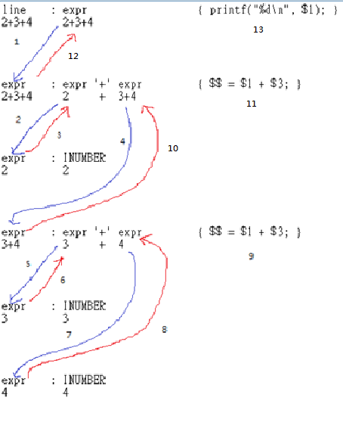
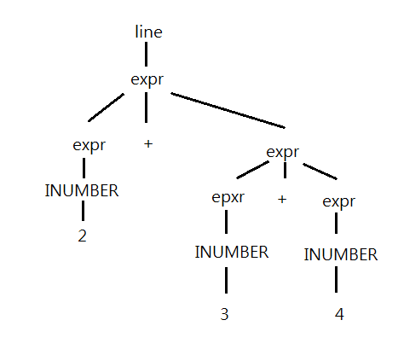
Example code Process Analysis
Ex:2+3+4

Slide 11
Compile and Run the Example
How to compile?
#compile bison
bison -d -o y.tab.c ex1.y
gcc -c -g -I.. y.tab.c
#compile flex
flex -o lex.yy.c ex1.l
gcc -c -g -I.. lex.yy.c
#compile and link bison and flex
gcc -o ex1 y.tab.o lex.yy.o -ll

Slide 12
Run
$ ./ex1
$ 1+2+3
Output：
$ 6

Slide 13
Practice 1
Use *.sh to execute compile command

Slide 14
The First Impression
The structure of a yacc program – three sections
Definition section: any initial C/C++ codes or definitions
Rules section: grammar + action, separated by whitespaces. A production rule consists of grammar and action.
Subroutine section: any legal C or C++ codes
Sections are separated by “%%” lines
… Definition Section … %% … Rules Section … %% … Subroutine Section …

Slide 15
The Subroutine Section
yyerror
deal with error . ex: sytax error
yyparse
Use the productions of rule section to analyze the syntax
Communication with yylex

Slide 16
The Rules Section
The context-free grammar used to generate the parser, the yyparse() function
A production can contain grammar and action
A production must be terminated with a semi-colon (;)
The action is executed on matching a production
‘|’ can merge productions having the same non-terminal at ‘:’ left
An example: expr : expr '+' expr |INUMBER
grammar
action
line : expr { printf("%d\n", $1); }
;
expr : expr '+' expr { $$ = $1 + $3; }
| INUMBER
;

Slide 17
Embedded Rule Action
We would like to do something when only parts of a production is matched
prod1 : A B { printf(“A B are seen”); } ;
prod1 : A { printf(“A is between B”); } B ;
This action will execute after A is analyzed done
The above production is equivalent to
prod1 : A B epsilon ; epsilon : /*empty*/ { printf(“A B are seen”); } ;
prod1 : A epsilon B; epsilon : /*empty*/ { printf(“A is between B”); } ;

Slide 18
Symbol Attributes
The attribute (value) associated with a symbol – yylval
In a Lex rule action, you can assign an attribute to a token
By default, yylval is of type int
By default, attributes associated with symbols are all type int
Attributes of symbols can be accessed by $$, $1, $2, $3 …
[0-9]+ { yylval = atoi(yytext); return(NUMBER); }
term : term ‘*’ factor { $$ = $1 * $3; } | factor { $$ = $1; /* the default action */} ; factor : NUMBER ;

Slide 19
Non-Integer Symbol Attributes
The %union directive
%union{ datatype variable-name; … }
yylval has all data type defined in %union,you can assign some data type to yylval
ex: yylval.ival = atoi(yytext); /*at *.l file*/
Declare data type for terminals and non-terminals
terminals: %token <variable-name> token …
non-terminals: %type <variable-name> non-terminal …

Slide 20
Synthesized VS Inherited Attribute
There are two types of symbol attribute for a non-terminal
Synthesized – depends only on itself and its children
Inherited – depends on its parent, itself, and it’s siblings
We have introduced the synthesized symbol attributes , which can be accessed by $$, $1, $2, …
ex in ex1.y: expr : expr '+' expr { $$ = $1 + $3; }
How to use attributes from parents?
Access parent attributes using $0, $-1, …
However, as we cannot see parents in the production, we have to explicitly assign its data type using $<varname>0, $<varname>-1, …

Slide 21
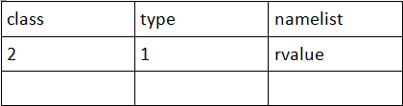
Inherited Attribute – an Example
declaration : class type namelist ; class : GLOBAL { $$ = 1; } | LOCAL { $$ = 2; } ; type : REAL { $$ = 1; } | INTEGER { $$ = 2; } ; namelist : NAME { mksymbol($0, $-1, $1); } ;
mksymbol : set the name’s type
ex: LOCAL REAL rvalue
rvalue will be set in symbol table
Given the above grammar of variable declaration
If default type is integer
mksymbol($0, $-1, $1)
If variable name for class and type is .class and .type, respectively
mksymbol($<type>0, $<class>-1, $1)

Slide 22
Practice 2
此練習為熟悉action，並了解Inherited的使用時機
分析的語法為：字串 字串 數字
.y file
line :test test integer 此production的action要輸出數字
integer :INUMBER 此production的action要輸出數字前的兩個字串
.l file
[a-zA-Z]+ 此rule的action把yytext的值丟給yylval

Slide 23
Practice 2 *.l file
%{
#include "ex2_1.tab.h"
%}
%%
\n { return(0); /* EOF */ }
[ \t]+ { /* do nothing */ }
[0-9]+ { yylval.ival= atoi(yytext); return(INUMBER); }
[a-zA-Z]+ {/*action of yytext value to yylval*/}
. { return(yytext[0]); }
%%

Slide 24
Practice 2 *.y file
%{
#include <stdio.h>
#include <string.h>
void yyerror(const char *message);
%}
%union{
int ival;
char* word;
}
%token<ival> INUMBER
%token<word> WORD
%type<ival> integer
%type<word> test
%%
line :test test integer {/*action of output integer*/}
;
test : WORD
;
integer :INUMBER {/*action of output inherited attribute*/}
;

Slide 25
Practice 2 *.y file
%%
void yyerror(const char *message)
{
fprintf(stderr, "%s\n",message);
}int main(int argc, char *argv[])
{
yyparse();
return(0);
}

Slide 26
Practice 2 hint
Use strdup to change yytext type to yylval
ex: yylval = strdup(yytext);

Slide 27
Practice 2 input & output
Input:
uuu ttt 123
Output:
first: uuu second: ttt
123

Slide 28
The Definition Section
Contains initial C or C++ codes
C/C++ Codes must be enclosed with “%{“ and “%}” lines
We will discuss other useful definitions later
A skeleton for embedding initial codes
%{ initial C or C++ codes %} … Other Definitions … %% … Rules Section … %% … Subroutine Section …

Slide 29
Token Declarations
%token: generic token declarations
%left: left-associative binary operators with precedence
ex: 9-3-2 = 4 not 8
%right: right-associative binary operators with precedence
ex: 2^2^3 = 256 not 64
%nonassoc: non-associative tokens with precedence

Slide 30
Generic Token Declarations – %token
Basic
%token token1 [token2 token3 …]
Ex: %token INTEGER DOUBLE STRING IF ELSE
Token numbers are assigned by yacc automatically
Higher than any other possible character code (256+)
Not conflicting with any literal tokens
Alternatively, you can manually assign the numbers
%token token1 [number1] [token2 [number2] …]
Ex: %token UP 50 DOWN 60 LEFT 17 RIGHT 25
Note: do not use zero as the token number
yylex() returns zero on end of file

Slide 31
Operator Precedence and Associativity
Declare operators in yacc
%left – left associative
%right – right associative
%nonassoc – non-associative
An operator declaration line is able to contain multiple operators, which have the same precedence
Ex: %left ‘+’ ‘-’
We declare operators in the order of their precedence, from lower to higher, for example
%left ‘+’ ‘-’
%left ‘*’ ‘/’
%right POW

Slide 32
Precedence Assignment – the %prec Directive
A token may have a higher precedence than it used to be
For example, the ‘+’ and the ‘-’ token
For a calculator, usually */ has higher precedence than +-
But, if +- are used as unary operator, i.e, -1, +2, it may have higher precedence than */
The below example gives ‘+’ the highest precedence when ‘+’ is a unary operator
The %prec directive gives the rightmost token (terminal) in the production an equivalent precedence to the specified token
%left ‘+’ %left ‘*’ %nonassoc UPLUS %% E : E ‘+’ E | E ‘*’ E | ‘+’ E %prec UPLUS ;

Slide 33
Practice 3
Simple calculator
calculate real number
‘+’ ‘-’ ‘*’ ‘/’ operation
‘(’ ‘)’ may appear on expression
Output to the first digit after the decimal point

Slide 34
Practice 3
Input :
2.0*2.5
5.0*(3.5+2)
5.25*3
Output:
5.0
27.5
15.8

